Slide 1


Slide 2


Fraud Detection
This project aims to enhance the accuracy of detecting fraud in mobile financial transactions. By leveraging machine learning, the project seeks to predict fraudulent transactions with high precision. The goal is to develop a robust machine learning model to accurately identify fraudulent transactions in real-time , enabling the company to improve security, reduce financial losses, and gain insights into factors contributing to transaction fraud.
Presented by : Nishar Badi

Slide 3


Introduction
The rapid growth of mobile money platforms has increased the risk of fraudulent activities.
Traditional fraud detection methods often struggle to keep up with evolving fraud techniques.
Machine learning algorithms can analyze large datasets to identify complex patterns and anomalies indicative of fraud.
Real-time fraud detection is essential to prevent financial losses and maintain user trust in mobile money platforms.
This project showcases the potential of machine learning to address a critical challenge in the financial technology industry.
In 2023 2.6million fraud report was recorded

Slide 4



Project workflow
01
02
03
04
Data Collection
Exploratory Data Analysis
PREPROCESSING
Split Train And Test Data
Collecting and organizing data to train machine learning models.
cleaning and preparing data to improve its quality and suitability
Analyze and visualize data to understand its behaviour
Split the dataset into training and testing sets to further proceed
02
02
03
Model Selection and
Model Training
Model Evaluation
Monitor and Update
Assessing the performance of a machine learning model using metrics
Continuously monitor the model's performance in the real-world scenario
Choosing a best machine learning algorithm and hyperparameter tuning

Slide 5
Features | Description
Step | Maps a unit of time in the real world. In this case 1 step is 1 hour of time
Type | CASH-IN, CASH-OUT, DEBIT, PAYMENT and TRANSFER
Amount | Amount of the transaction in local currency
NameOrig | Customer who started the transaction
OldbalanceOrg | Initial balance before the transaction
NewbalanceOrig | New balance after the transaction
NameDest | Customer who is the recipient of the transaction
OldbalanceDest | Initial balance recipient before the transaction. Note that there is not information for customers that start with M (Merchants)
NewbalanceDest | New balance recipient after the transaction. Note that there is not information for customers that start with M (Merchants)
isFraud | Transactions made by the fraudulent agents

Slide 6

Exploratory Data Analysis
Exploratory Data Analysis (EDA) helped to understand the data structure, identify trends, and understand patterns from the datase
Visualizing to see the data cearly and understand relationship fo features with each other .
The dataset has no NULL values but we can find some outliers.
The Dataset has 11142 entries with 10 columns, 5 of type float64, 2 of type int64, and 3 of type object.
We calculated the summary of statistical metrics for the DataFrame's numerical columns, such as count, mean, standard deviation, minimum, maximum, and quartiles, offering a quick overview of the dataset's distribution and characteristics.

Slide 7
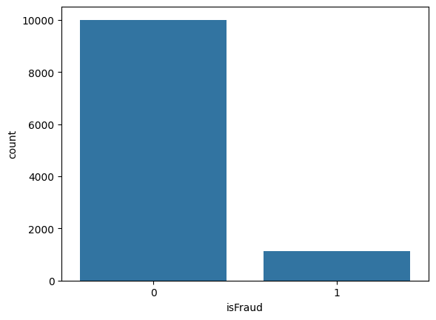
Fraudulent counts
The count plot from the visualization shows the distribution of fraud (where isFraud is 1) vs non-fraud transactions (where isFraud is 0).
Fraud counts = 1142 & Non fraud counts = 10000
The plot indicates a significant imbalance, with far more non-fraud transactions compared to fraud ones.
This imbalance can present challenges for fraud detection models, requiring techniques to address skewed data.

Slide 8
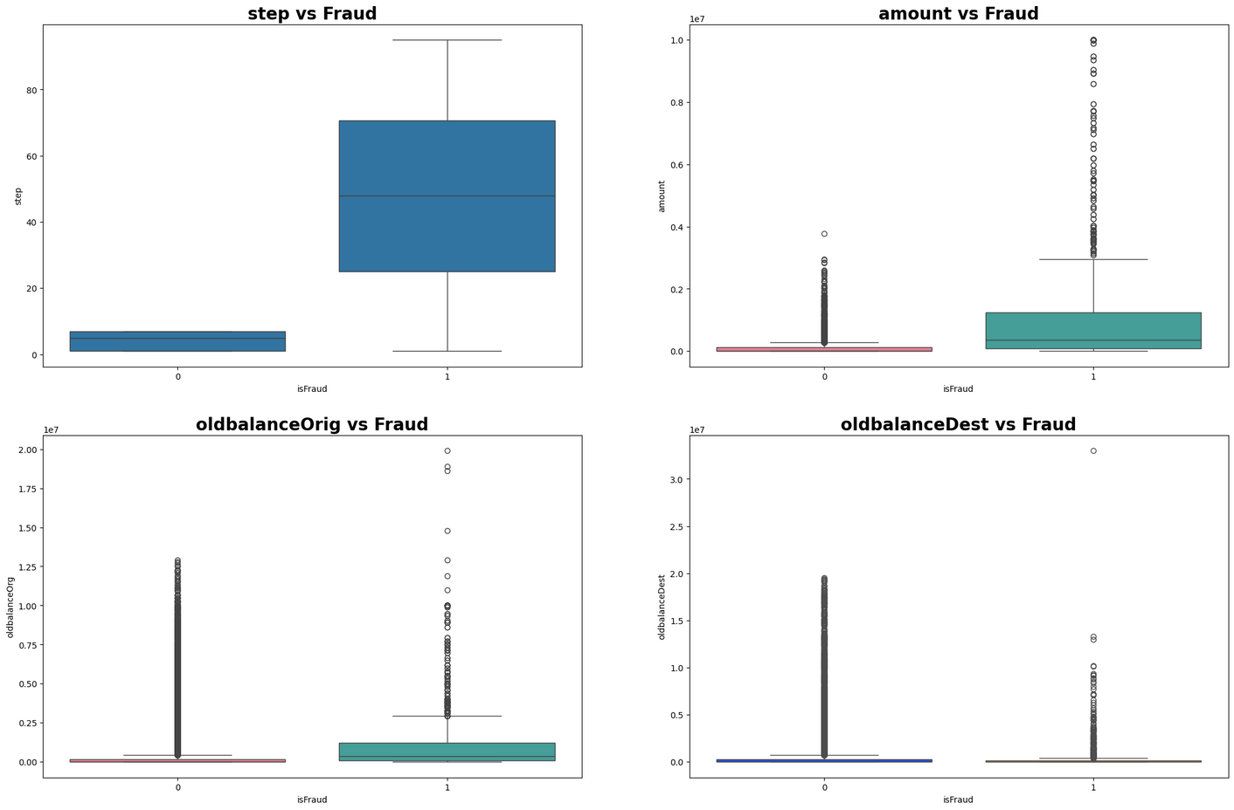
The plot visualization has four panels, each for a different feature's distribution with respect to fraud.
The first panel shows `step` vs. `isFraud`, indicating higher dispersion in fraudulent transactions.
The second panel plots `amount` vs. `isFraud`, with notable outliers among non-fraudulent transactions.
The third panel visualizes `oldbalanceOrg` vs. `isFraud`, revealing many high outliers in non-fraudulent cases.
The fourth panel, depicting `oldbalanceDest` vs. `isFraud`, also shows more variability and extreme outliers among non-fraudulent transactions.
These boxplots help identify discrepancies in data distributions between fraudulent and non-fraudulent transactions, which can guide further analysis and model development.

Slide 9
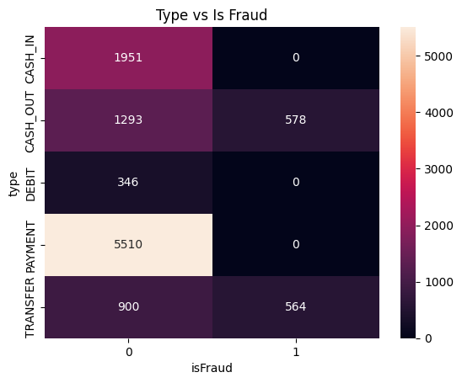
Categorical Distriution
This indicate that fraudulent transactions mainly occur in CASH-OUT and TRANSFER types, suggesting that fraud detection strategies should prioritize monitoring these high-risk categories.

Slide 10
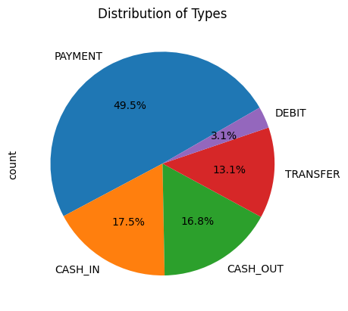
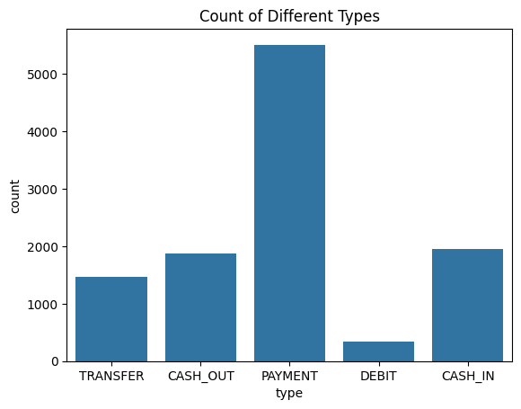
Distribution of transaction types
The two visualizations displays the distribution of transaction types in a dataset.
Count Plot: This bar chart illustrates the frequency of each transaction type. CASH-OUT and PAYMENT are the most common occurrences . CASH-IN is less frequent, followed by TRANSFER. DEBIT is the least common, showing minimal activity.
Pie Chart: This pie chart represents the percentage distribution of transaction types. PAYMENT has the highest proportion at 49.5%, with CASH_IN close behind at 17.5%. CASH-OUT represents 16.8%, while TRANSFER is 13.1%. DEBIT is the smallest slice, comprising just 3.1% of transactions.
These plots give a comprehensive overview of transaction distribution, revealing the relative prominence of each type and helping identify potential areas for further analysis, such as identifying trends or spotting anomalies related to fraud detection.

Slide 11
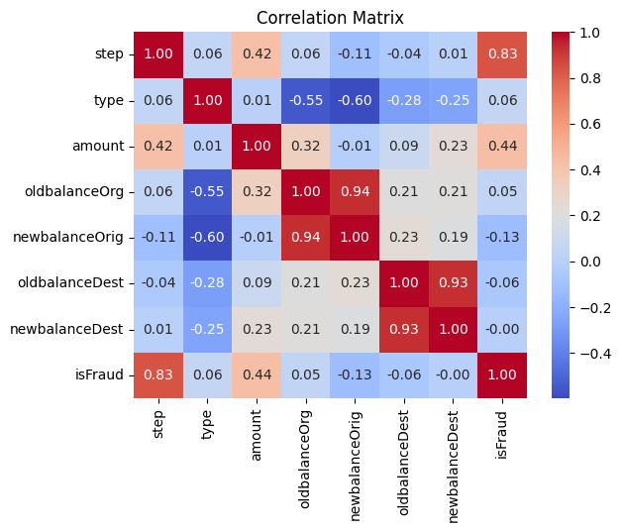
Correlation Matrix
Positive correlation were observed between the target variables and “Step”, “Oldbalancedest” and “Newbalancedest”.
“Newbalancedest” has no relation with target variable.
“Newbalanceorig” and “oldbalanceorg” have negative correlation with “Type”.

Slide 12

Data Preprocessing
The dataset has no missing values, so there's no need for data imputation or removal due to null entries.
Converts categorical variables into numerical representations through labelencoding, facilitating their use in machine learning algorithms that require numerical input for processing.
Dropped irrelevant features nameorig and namedest

Slide 13

SPLITING THE DATA INTO X & Y
20% Test Data
Divided the dataset into two parts: X and y.
"X" represents the independent Variables, and "y" represents the Dependent (target variable) that we want to predict or understand.
TRAIN TEST SPLIT
Divided the data into training (80%) and testing (20%) sets.
Setting a random state ensures consistent results and maintains a proportional distribution of the target variable in both sets.
80% Train Data

Slide 14
Model Selection
Logistic Regression: logistic Regression is commonly used for binary classification problems. it's preferred because it provides a simple an efficient way to model the relationship between the independent variables and the probability of a certain outcome.
Random Forest Algorithm: Random Forest: Random Forest is a robust supervised algorithm suitable for both regression and classification tasks.
Decision Tree: Decision Tree algorithms are used for classification because they are simple, computationally efficient, and effective in handling high-dimensional data. Works best for categorical independent columns.
Gradient Boosting Classifier: It is one kind of ensemble learning method which trains the model sequentially and each new model tries to correct the previous model. It combines several weak learners into strong learners. There is two most popular boosting algorithm

Slide 15
Model Comparison
Accuracy
%
Precision
%
Recall
%
F1 Score
%
AUC Score
%
Logistic Regression
96 | 83 | 80 | 82 | 92
99.4 | 99 | 96 | 97 | 99.1
99.5 | 99 | 96 | 98 | 99.9
99.5 | 99 | 97 | 98 | 98
Random Forest
Gradient boosting
Decision Tree
Precision: The accuracy of the model when it claims to have found something.
F1 Score: A balance between recall and precision, useful when both false positives and false negatives need to be minimized.
Recall: Recall: The ability of a model to find all the relevant cases
AUC score: a metric that measures how well a classifier can distinguish between positive and negative classes

Slide 16
Conclusion
CASH-OUT and TRANSFER transactions are the primary methods used for fraudulent
A significant class imbalance exists in the dataset, with the majority of transactions being legitimate.
Several features, including transaction amount, time step, and account balances, exhibit strong correlations with fraudulent transactions.
Decision Trees and Random Forests emerged as the top-performing models, achieving accuracy exceeding 99%.
Logistic Regression, while less accurate than the other two models, still demonstrated good performance with an accuracy of 96.3%.
The project successfully validated the potential of machine learning to enhance fraud detection capabilities in mobile money systems.

Slide 17

THANK YOU

